Slide 1



IMPLEMENTATION OF THE MINIMUM TOP-UP TAX
Pillar 2
COMPLEXITIES & CHALLENGES FOR TAX ADMINISTRATION & ENTERPRISES

Slide 2
AGENDA
1. Intro P2
4. Three layers of legislation
7. Data
2. Milestones for implementation
5. Processes & applications & tools implementation
8. Dialogue with business & consultants P2
3. Group approach MNE’s in compliance & auditing
6. People : organizational aspects P2
9. Q&A

Slide 3
1. INTRO - OVERVIEW PILLARS
Pillar 1
Amount A = Re-allocation of taxing rights
Amount B = Special considerations for baseline marketing and distribution activities
Pillar 2 = MNEs pay fair share of tax wherever they operate
Domestic rules = QDMTT + Global anti-Base Erosion mechanism (IIR & UTPR)
Treaty-based rule = Subject to tax rule (STTR)

Slide 4
1. INTRO - SIX KEY STEPS OF THE TOP-up tax
1
Determine whether the MNE Group is within scope
2
Allocate income of Constituent Entities on a Jurisdictional Basis
3
Calculate the GloBE Income
4
Determine Adjusted Covered taxes
5
Compute the Effective Tax Rate and calculate the Top-up Tax
6
Charge the Top-up Tax under QDMTT, IIR or UTPR

Slide 5
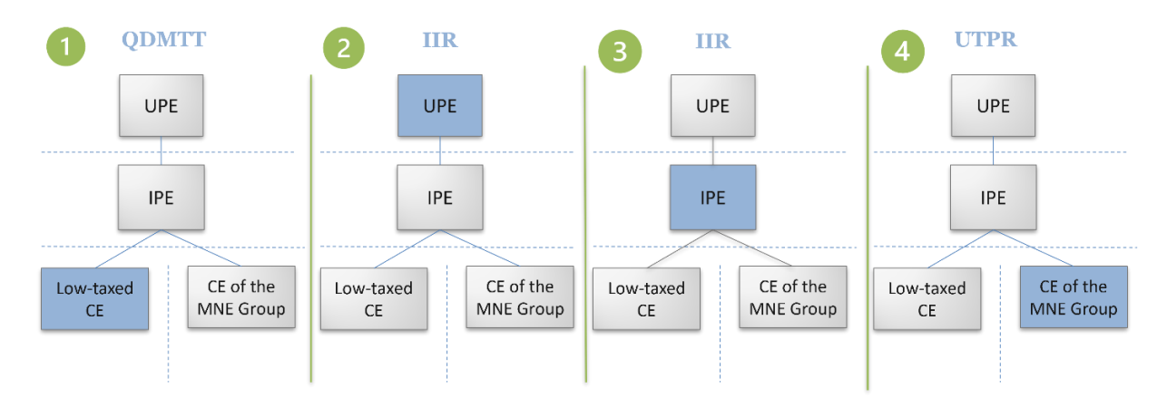
1. INTRO – Agreed Rule order

Slide 6
2. MILESTONES FOR IMPLEMENTATION
! ATTENTION ! FRAMEWORK STILL UNDER CONSTRUCTION
2024
2025
2026
Q2: Notification group number
Q2: Filing the Globe Information Return (GIR)
Q4 : Tax return QDMTT
Q2/Q3: Notification prepayments
Q3 2026 = Tax return IIR
Q3/Q4: making prepayments
Q3 2026 = Making remaining payments
Q4: Notification Tax returns (QDMTT and IIR) & GIR

Slide 7
3. Group approach MNE’s in compliance & auditing
Focus on group level:
Company = part of larger picture in MNE context
Relationships between companies = important = FAR analysis
Mapping all interactions and risks within a (multi)national group (not only for TP/P2 purposes) = holistic approach
Challenges:
Group approach + “compliance - audit" approach requires flexibility of our agents
Joining forces and strengthening each other is key to success!

Slide 8



4. Three LAYERS OF LEGISLATION
OECD AS IS Model GloBE Rules Commentary Administrative Guidance Examples GloBE Information Return Safe Harbours and Penalty Relief Implementation Handbook TO BE Administrative guidance | EU AS IS Council Directive (EU) 2022/2523 of 14.12.2022 Also, for large-scale domestic groups in the EU TO BE FAQ’s | BELGIUM AS IS Parliament 55K3678 Election to apply a qualified domestic top-up tax system Prepayments TO BE Additional legislation

Slide 9
5. Processes & Applications & Tools Implementation
Launch of project early 2024 to implement Pillar Two: technical and organisational solution.
Momentarily : launch of Business Case – 3 different sub phases
1st phase : organising notification system for MNE’s and large-scale domestic groups for Pillar Two. Belgium : important aspect: prepayments system for QDMTT and IIR
3rd phase : creation of structure for international exchange of information.
Important = reciprocal input from all necessary stakeholders within FPS Finance – attention for the multidimensional impact of the implementation
2nd phase : development of e-services for MNE’s and large-scale domestic groups for, a.o., filing of tax returns and GIR, as well as development of back office applications.

Slide 10
6. PEOPLE : organizational aspects P2
Workgroup implementation P2 : follow up development implementation P2
Staffing P2 Team LE & OES : “pioneers”
116 employees in total
profiles = tax accountants & international taxation
Training program : Accounting / CIT / TP / IFRS / P2
Large Enterprises Unit : focus on four different areas : Compliance / Risk analysis / Audit / Disputes

Slide 11






7. DATA
FINDING THE RIGHT BALANCE BETWEEN
TRUST
TRANSPARENCY
TECHNOLOGY
Several notifications & tax returns
GIR = lots of tables (> 50) with lots of datapoints
Strong need for different ICT Tools (internal & external)
Interlink between TP / CIT / P2
Link with other data sources

Slide 12

8. DIALOGUE with business & consultants P2
What are the issues
and needs
of the
business?
Pilar Two?
Exploring the possibility to start up a dialogue with the business & consultants (external stakeholders) concerning the implementation of Pillar Two
What is the implementation plan?
Business are concerned !

Slide 13


Q & A

Slide 14

THANK YOU

