Slide 1

Pillar 2 – Belgian Implementation of the Minimum Tax – Complexities & Challenges
IFA – 12 December 2023

Slide 2
Agenda
Setting the scene
It’s not just about tax…
Multi stakeholder engagement
Data
Processes
Technology
Timing
Cost
Conclusion

Slide 3
Setting the scene
MNEs are not against Pillar 2
A tax floor assuring fair taxation is noble and resonates in a world where ‘sustainability’ is becoming the baseline
Interesting discussions at Board of Director level – Review of MNE tax footprint
MNEs do observe
Is ‘sustainability’ component really reached?
Cui bono?
Unharmonized timing
US
EU: Estonia, Latvia, Lithuania, Malta and Slovakia – delay requested
CH
Unharmonized rules
US?
EU => OECD interprétations after EU Directive? Blend between ‘hard’ and ‘soft’ law can & will lead to cross-border litigation – Bulgaria no substance based carve-out
HUGE IMPACT ON COMPLIANCE POSITION & TEAMS

Slide 4
It’s not just about tax… that would be too easy, right?
Pillar 2
Data
Processes
Technology
Timing
Cost
Multi-stakeholders

Slide 5
Multi stakeholder engagement
Alignment between teams is crucial to model impact and capture the right data but difficult in practice
IFRS definitions ≠ Pillar 2 definitions (consolidation perimeter, deferred taxes, …)
Some data only available in consolidation accounting layers or other IT systems
Change in presentation of financial statements (legal validation)
Deferred taxes are not captured in regular modelling or forecasting exercise as they are tax rate neutral for IFRS(*)
Shooting on a moving target (changing definitions => pre-regime loss utilisation, R&D tax credit in key countries, …)
Iterations exhaust people
Tax team only team with oversight – no back-up
Excom/Board
Talent
Legal
Tax Team
FP&A
Accounting
IFRS conso
IT
+ EXTERNAL PROVIDERS
(*) Exceptions exist – e.g. DTA remeasurements

Slide 6
Data & Processes
Capturing all data points (266!) proves difficult
Data from different systems (consolidation system, accounting system, payroll tax system,…) with different output
Lot of MNEs have different accounting systems in place (eg diff. versions of SAP)
P2 requires full local IFRS P&L/BS => some IFRS data only available in IFRS consolidation layer (e.g. Share Based Payments)
IFRS definitions ≠ Pillar 2 definitions
And what about the information returns?
New processes to be established
Data processes linking all data in a comprehensible manner for the Pillar 2 reporting system
Closing process: P2 is a full additional layer on top of IFRS tax closing processes
No fit in regular closing calendar - additional days difficult for stock-listed companies
Financial teams fully booked during reporting period
Review processes by external auditor (no practice yet)
Elections on deferred taxes?
Management of (legal) liability and cross-border litigation cases?

Slide 7
Technology, Timing & Cost
Technology = only way to tackle Pillar 2 reporting & compliance
Ideally, Pillar 2 reporting tool links to IFRS/US GAAP tax reporting tool
Vetting procedure for tax technology tool = lengthy (security/testing/…)
Data feed to systems is problematic
Unharmonized rules complicate programming
Financial teams to be trained on software
External auditor needs to perform system testing
Timing: December 2024 right around the corner (for calendar year-end companies)
Prepayment assessment is complicated for all jurisdictions involved and depends on all above parameters
Testing software, data and outcome is a full-time job (next to ever increasing compliance work) and puts strain on the teams
Costs: Internal resources, software licences, external advisors create huge costs just in assuring future compliance

Slide 8
Conclusion
MNEs will embrace the Pillar 2 concept and live up to the global (& local) requirements
MNE management will assess the necessity and benefit of making structural changes to the MNE group due to changed landscape – Other drivers than tax may become more dominant
Pillar 2 introduction puts large strain on tax teams and their stakeholders in
Harnessing financial & tax data
Setting up new financial processes
Managing the technical Pillar 2 content
Performing cost control on the Pillar 2 compliance cost
The evolving tax landscape makes it increasingly difficult to connect all the dots (e.g. BEFIT may bolt again another layer on tax reporting)
Final reflection… on 8 December 2020, I gave an IFA presentation ‘Pillar 2 – Unraveling the practical impact’
Pleading for what (innovative) companies seek to do business
A strong innovative business ecosystem, strong educational system and an encouraging tax framework
Clear, consistent and stable tax legislation, APAs and efficient litigation
Manageable compliance: reduction of complexity and manageable compliance cost
Are we meeting this?

Slide 9
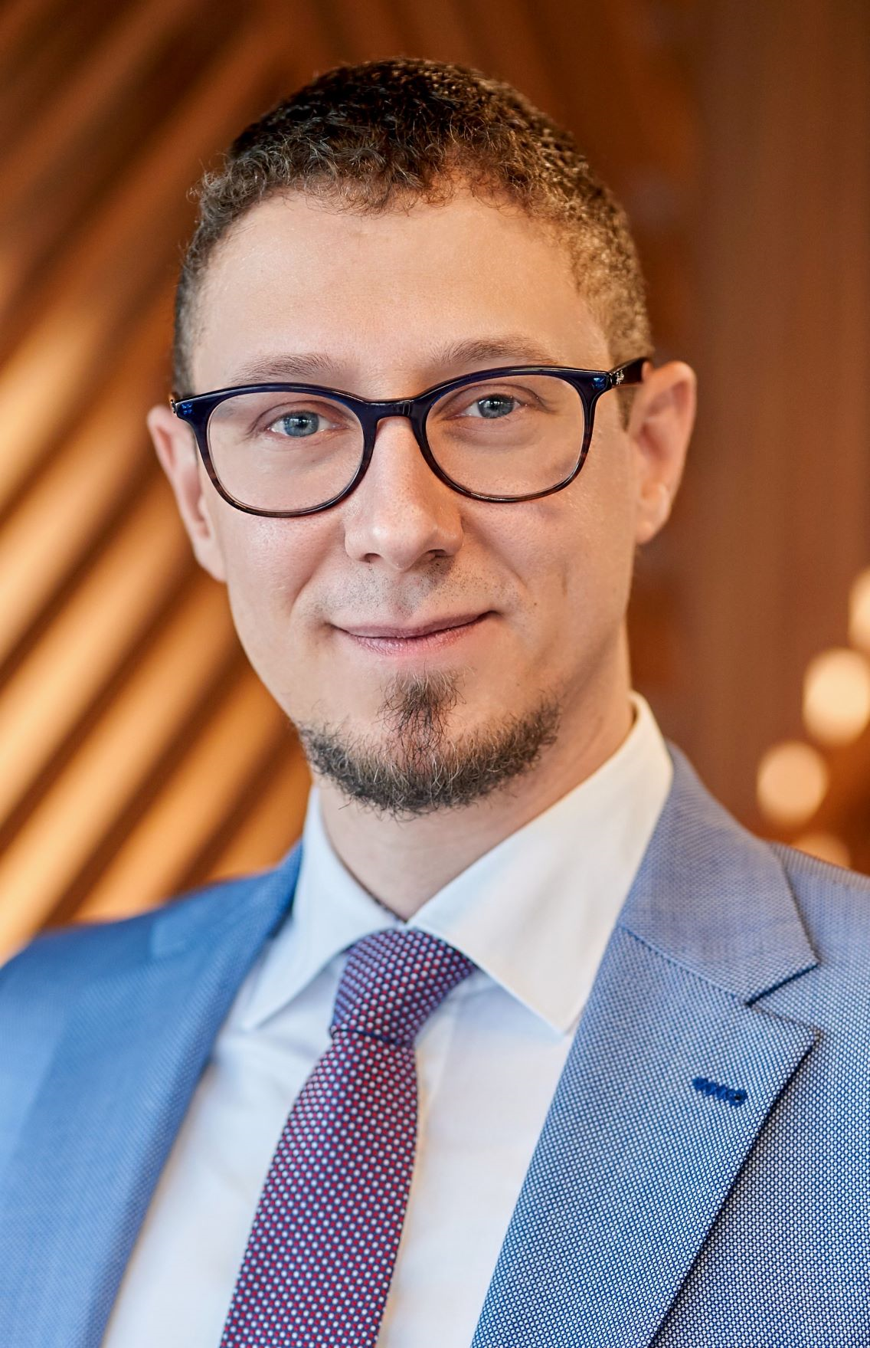
Contact detail
Description: Tax professional with a passion for innovation & linking financial accounting and income tax. Guardian of correct application of tax law & tax procedural rules. Believer in tax policy as enabler to for long term prosperity.
Born: 20 February 1983
Professional experience:
2016-today: UCB Global Head of Tax (2021-now) Director Tax Europe – Tax Accounting – Tax Policy (2016-2021) International Tax, Transfer Pricing, Income Tax Reporting (IAS 12), Tax digitalisation & Tax compliance
2007-2016: PwC Belgium Consultant to Senior Manager International Tax, Transfer Pricing, Income Tax Reporting (IFRS/US GAAP/BE GAAP) & Tax Compliance
Dennis Beyers
Vice President - Tax
Mob : +32 (0) 493 240 690
Mail: dennis.beyers@ucb.com
The participation to IFA is given in my own name and in my capacity as international tax specialist anchored in a Belgian biopharmaceutical MNE, Belgian citizen and dedicated believer in innovation as driver for long term economic growth and prosperity supported by an appropriate attitude to tax policy. I do not act as a representative of UCB nor any other pharmaceutical company.

Slide 10
In spite of all the challenges, taxpayers will manage their Pillar 2 challenges Tax directors: be kind to your teams solving the Pillar 2 conundrum Tax advisers: be as efficient and practical as possible Tax authorities: understand that perfection may not be there as from day 1

